Slide 1
KWL Chart
Make a KWL Chart on what you know about photosynthesis and cellular respiration, what you want to learn, and then we will look back at it after we have discussed Photosynthesis and Cellular Respiration to see what you have learned.

Slide 2
What I Know | What I Want to Know | What I Learned

Slide 3
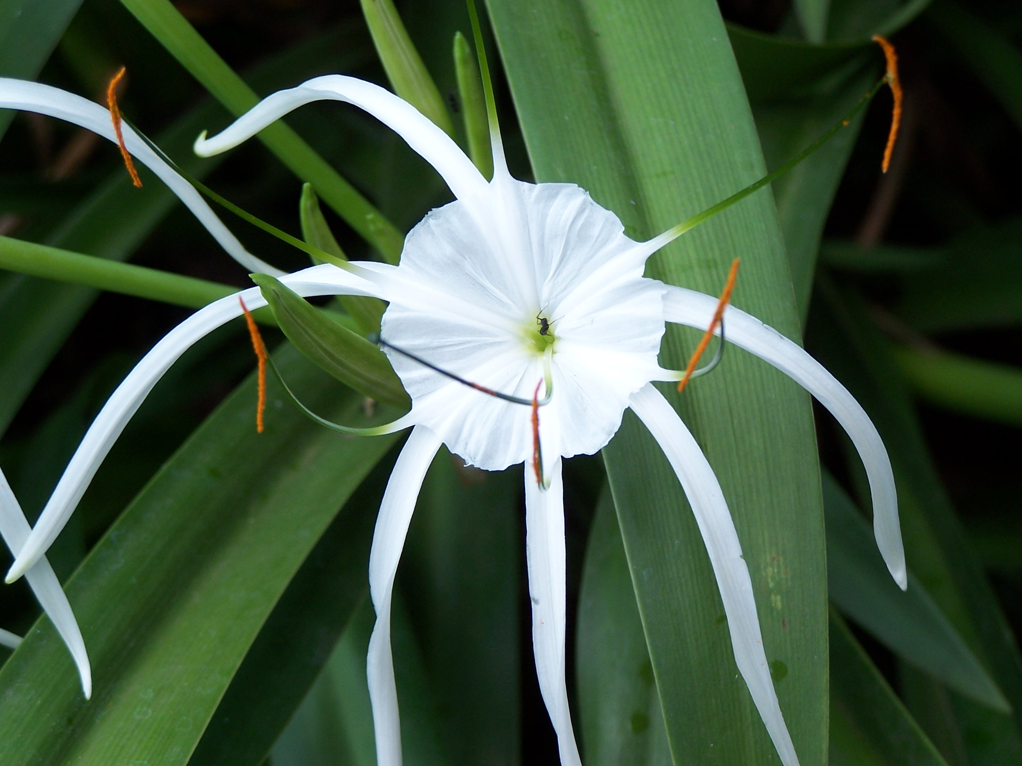
Photosynthesis
Notes
Objective 1: Describe the process and importance of photosynthesis. (Importance, Reactants, Products, Location
Objective 2: Write a balanced chemical equation for photosynthesis.

Slide 4

Photosynthesis Notes
Photosynthesis:
process by which producers convert light energy from the sun into chemical energy in the form of glucose (food).
Importance:
converts light energy into stored energy using inorganic materials.

Slide 5
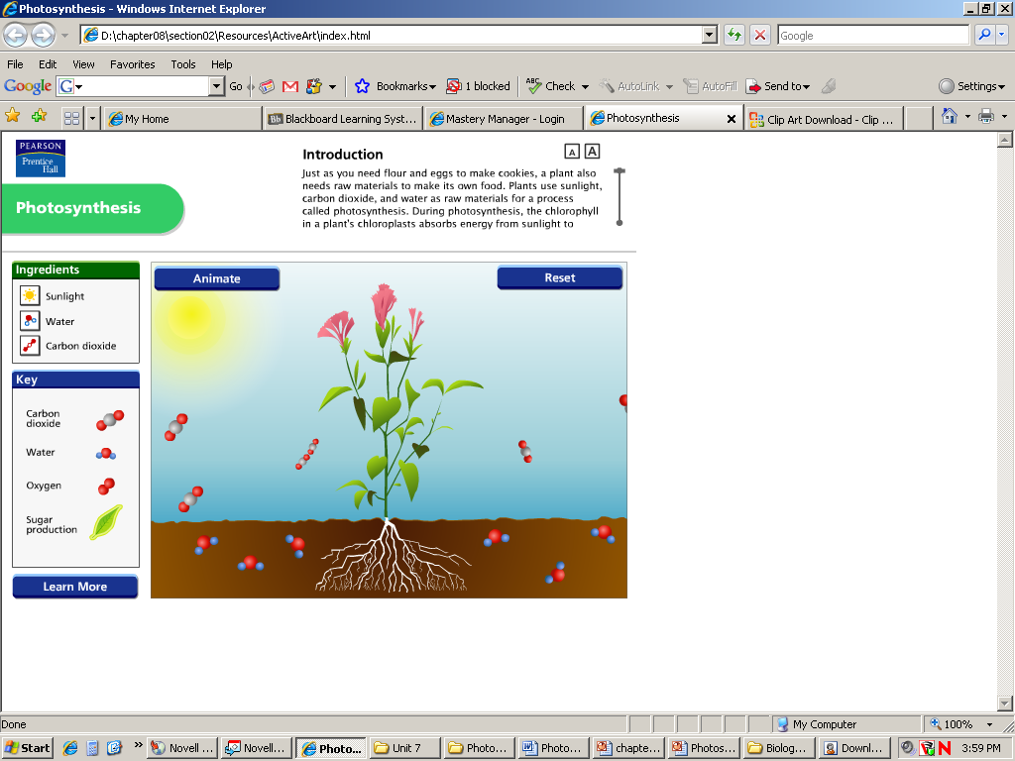

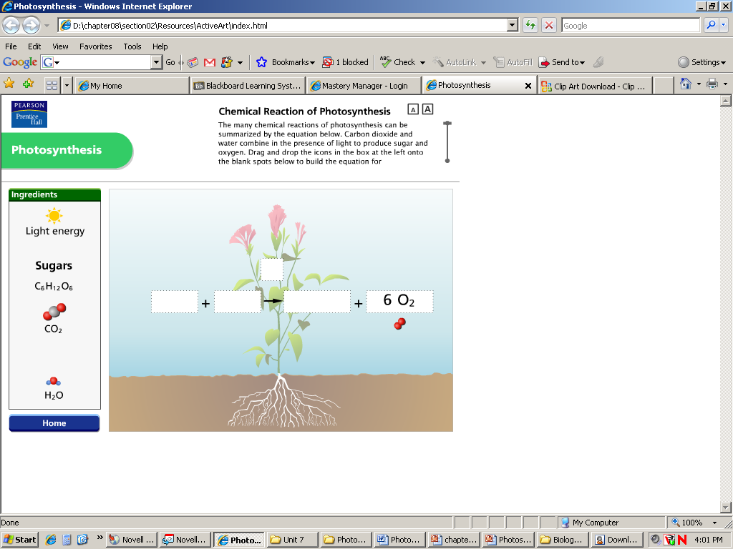
Photosynthesis
Reactants:
  carbon dioxide – 6CO₂
  water – 12H₂O
Products:
  glucose – C₆H₁₂O₆
  oxygen – 6O₂
  water-6H₂O

Slide 6
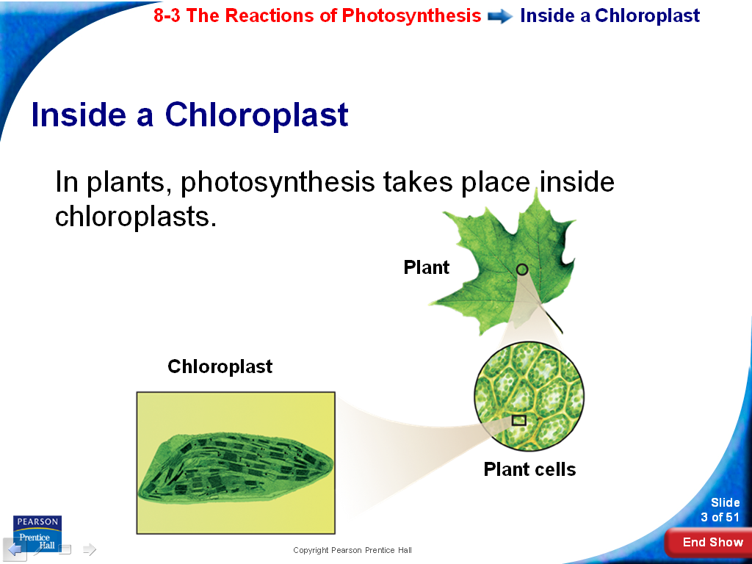
Photosynthesis
Location:
in the chloroplasts

Slide 7
Photosynthesis
Other Things Necessary:
Chlorophyll: the light-capturing pigment found in the chloroplast that absorbs all wavelengths (colors) of light except green. Traps electrons and transfers energy.
Sunlight: autotrophs need light energy (sunlight) to transform reactants into products.
Enzymes: enzymes are needed to catalyze the reaction.

Slide 8
The Light-dependent reaction takes place in the thylakoid membranes. Thylakoids are saclike photosynthetic membrane. Thylakoids arranged in stacks are called grana.
The Light-Independent (Dark) reaction takes place in the stroma – region outside the thylakoid membranes. AKA – The Calvin Cycle

Slide 9
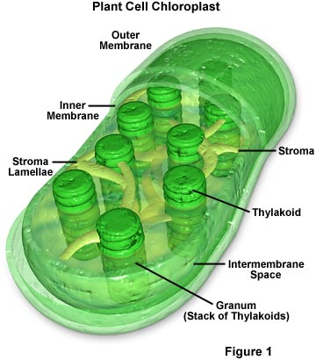
Look at all
the detail!

Slide 10
Light-Dependent Reactions
Requires sunlight!
Sunlight → Absorbed by chlorophyll in the thylakoid (electrons) → electron transport chain → splits water and makes ATP
Light energy is converted to chemical energy in the form of ATP
The sunlight excites electrons in the chlorophyll – these require carriers.
Cells use electron carriers to transport these high energy electrons known as the electron transport chain

Slide 11
Light-Dependent Reactions Continued
To continue the process water from the thylakoid membrane is split – the hydrogen atoms donate the electrons and OXYGEN is released as the byproduct!
Energy used to transport H+ ions from stroma to thylakoid membrane
H+ ions fill the inside of the cell and react with ATP synthase to create ATP

Slide 12
Main Ideas – Light Dependent Reactions
Reactants = Sunlight, Water, ADP, NADP+
Products = Oxygen, ATP, NADPH

Slide 13
Light-Independent Reaction (Calvin Cycle)
Does not need light
Use products of light-dependent reactions
Occurs in the stroma of the chloroplast
Calvin Cycle – use energy that ATP and NADPH contain to make compounds (glucose) that can be stored for a long period of time

Slide 14
Light-Independent Reaction (Calvin Cycle)
Reactants = CO_{2,} ATP, NADPH
Products = glucose, water, ADP, NADP+
The cycles work together to keep the process moving!
Light-dependent traps the energy
Calvin Cycle (dark) uses the energy to produce stable, high energy sugars

Slide 15
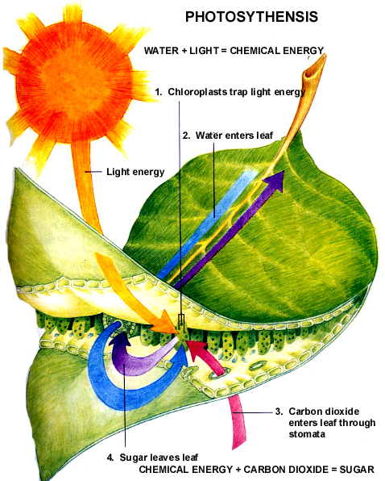

Slide 16
Summary of Photosynthesis
Chlorophyll and other pigments located in the chloroplasts absorb the sun’s energy, which stimulates carbon dioxide and water to react and form glucose and oxygen.
The energy is stored in the bonds of the glucose. Organisms must break these bonds (do cellular respiration) to get the energy.

Slide 17
Photosynthesis Equation
Balanced Equation:
Energy + chlorophyll
enzymes
6CO₂+12H₂0 C₆H₁₂O₆+6O₂+6H₂0

Slide 18
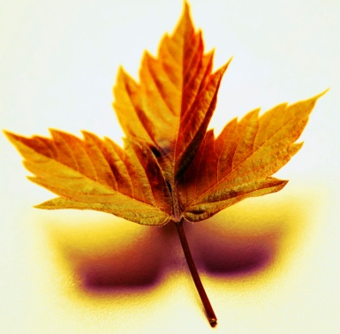
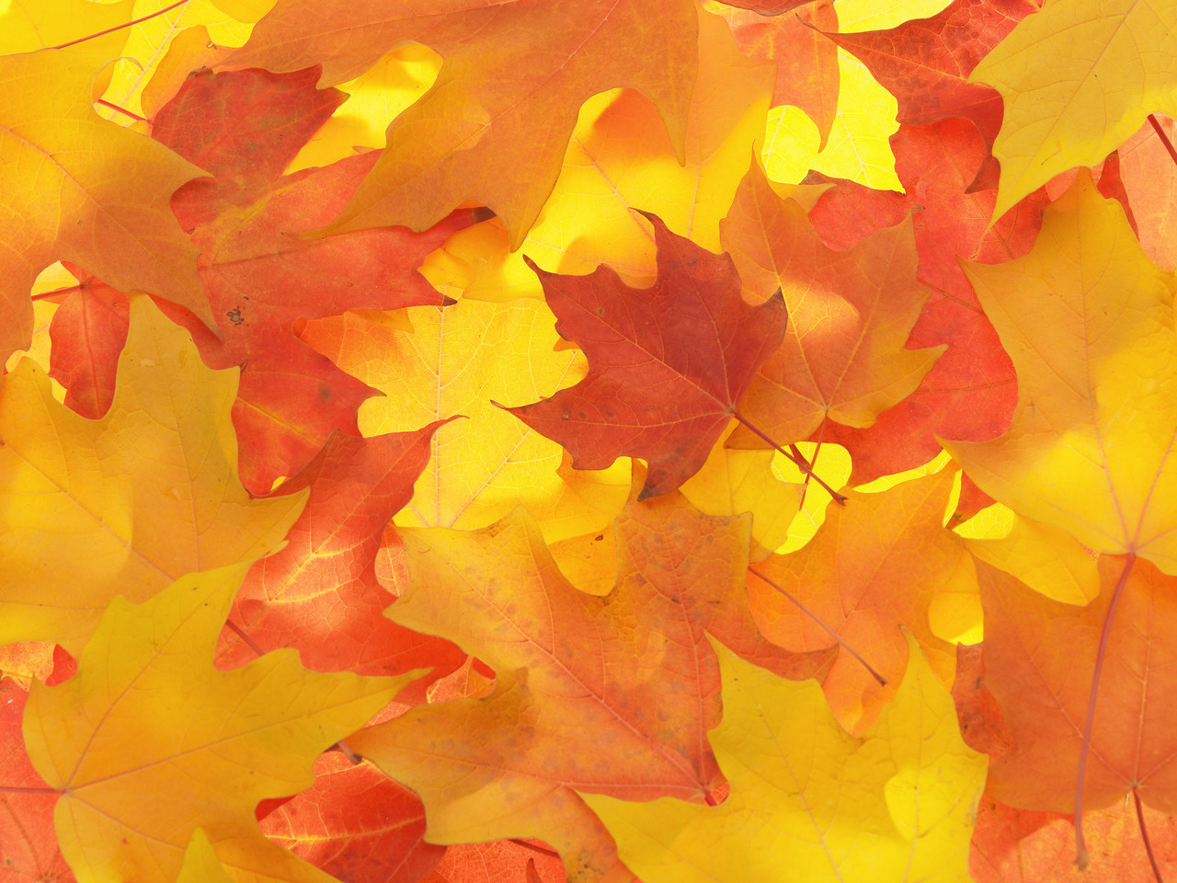
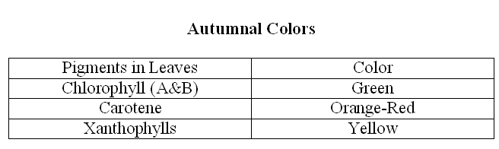
Autumnal Colors

Slide 19
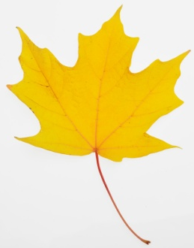
Why Colors?
Chlorophyll breaks down quicker (because of less water) than other pigments.
Different trees have different amounts of each pigment, creating different colors.
Variety of colors is caused by differing amounts of water and types of trees.

Slide 20
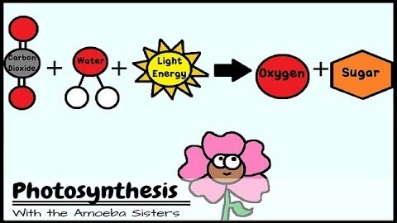

Slide 21
Cellular Respiration
Objective 4: Describe the process and importance of cellular respiration. (Importance, Reactants, Products, Location)
Objective 5: Write a balanced equation for cellular respiration.

Slide 22
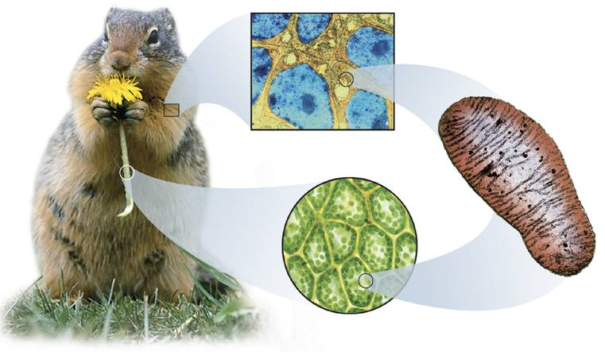
Cellular Respiration
Animal
Animal Cells
Mitochondrion
Plant
Plant Cells

Slide 23
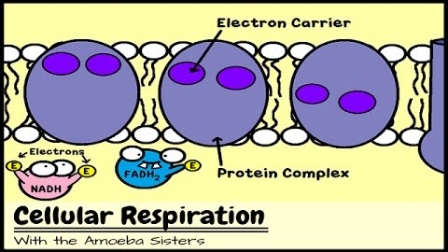

Slide 24
Cellular Respiration (All living things)
Cellular Respiration: process by which food energy (glucose) is broken down to form usable energy (ATP).
Importance: Converts energy to a form that is directly usable by our cells (ATP)!

Slide 25
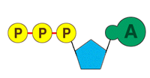
Cellular Respiration Reactants & Products
Reactants:
glucose – C₆H₁₂O₆
oxygen – 6O₂
Products:
carbon dioxide – 6CO₂
water – 6H₂O
ATP (usable chemical energy)
heat energy

Slide 26
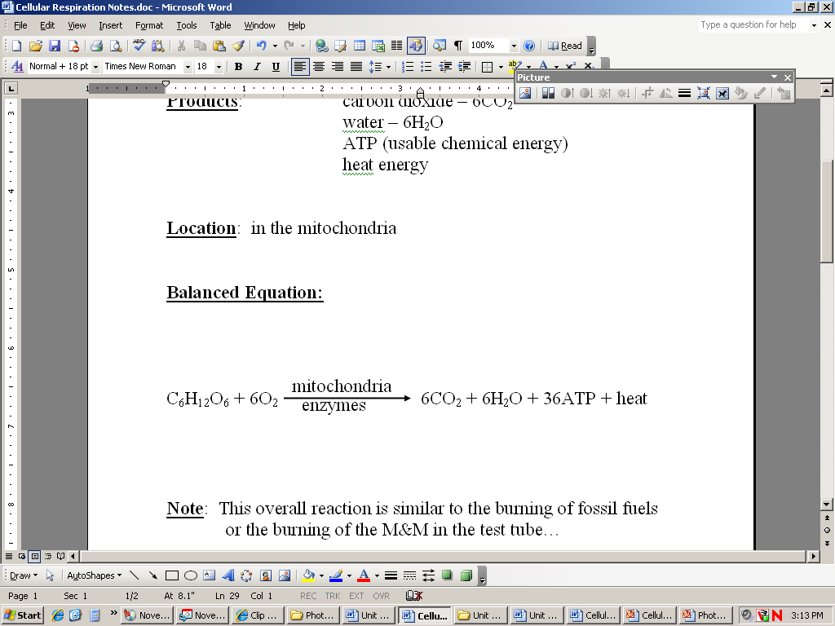
Cellular Respiration Balanced Equation
glucose + oxygen carbon dioxide + water + ATP + heat
Sugar from food and oxygen from the air is needed to make energy. Cellular respiration must be performed constantly to give living organisms a continuous supply of energy

Slide 27
There are 3 steps in the process of cellular respiration
  1. Glycolysis
  2. Krebs Cycle (Citric acid cycle)
  3. Electron transport chain

Slide 28
1. Glycolysis
Glucose 2 pyruvic acid + 2 ATP’s +H’s
Aerobic vs Anerobic Respiration
enzymes

Slide 29

Aerobic Respiration
occurs in mitochondria
oxygen is required
Amount of usable energy converted: 36 ATP for each molecule of glucose
Process: glucose is broken down through a series of steps, piece by piece, so that a large portion of its stored energy can be utilized by the cell. This is the most efficient way to break down glucose.
Waste products: water, carbon dioxide, and heat

Slide 30
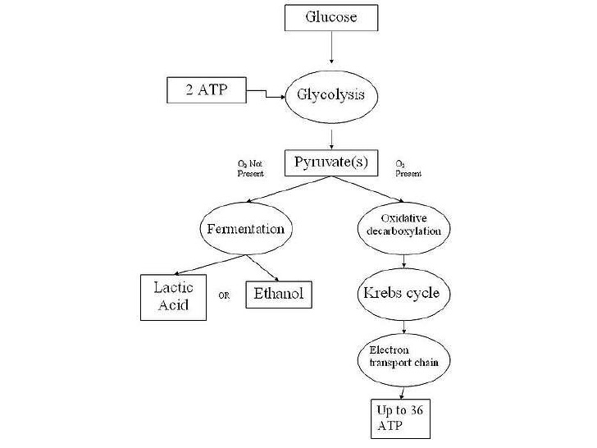

Slide 31
Aerobic Respiration
a. Pyruvic acid → acetyl CoA
b. Krebs cycle: 2 molecules of ATP, energy carrier molecules (H+) and CO ₂ from each glucose molecule.
c. Electron transport Chain (ETC) is a series of chemical reactions that produces 34 ATP molecules and H₂O from the carrier molecules that were produced in the Krebs cycle

Slide 32


Slide 33
2. Anaerobic Respiration
Occurs in fully anaerobic organisms (never use oxygen)
Occurs in aerobic organisms (i.e. humans) for short periods of time
occurs in cytoplasm
oxygen is not required
Amount of usable energy converted: 2 ATP for each molecule of glucose

Slide 34
Anaerobic Respiration
Two major types:
  Alcoholic Fermentation:
      Occurs in yeast
      Waste products: ethyl alcohol and carbon dioxide
  Lactic Acid Fermentation:
      Occurs in animals, when no oxygen is present (when oxygen cannot get to muscles quickly enough)
      Waste products: lactic acid and carbon dioxide

Slide 35
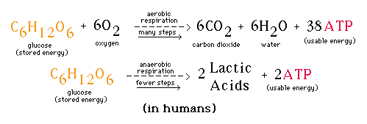
+36

Slide 36
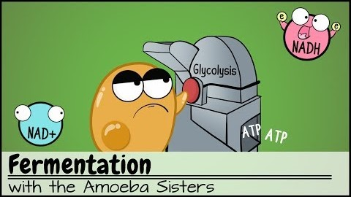

Slide 37
Determine if each statement describes
photosynthesis, cellular respiration, or both
  Releases Energy
  Needs Light to Occur
  Gives off Carbon Dioxide
  Animals use this Reaction
  Plants use this Reaction
  Needs chlorophyll
  Makes glucose
  Waste products are carbon dioxide and water
  Waste product is oxygen
  Occurs in mitochondria
  Occurs in chloroplasts

Slide 38
  Releases Energy (CR)
  Needs Light to Occur (P)
  Gives off Carbon Dioxide (CR)
  Animals use this Reaction (CR)
  Plants use this Reaction (Both)
  Needs chlorophyll (P)
  Makes glucose (P)
  Waste products are carbon dioxide and water (CR)
  Waste product is oxygen (P)
  Occurs in mitochondria (CR)
  Occurs in chloroplasts (P)

